Slide 1
Research on the Relationship between
Gun Laws and Gun Violence using
Machine Learning
By
Aryan Deorah (AOS) Chris Goodhart (AOS)
Juhyeok Choi(DSHS) Jiwon Park(DSHS)

Slide 2
History of Gun Violence in 20th century
•First major federal regulation: National Firearms Act of 1934
Passed in 1934, taxed the making and transfer of firearms
Also required registration of firearms
•Federal Firearms Act of 1938
Only licensed individuals can sell firearms
•Lasting problem in America
Firearm homicides have been highest cause of death for adolescent African American males

Slide 3
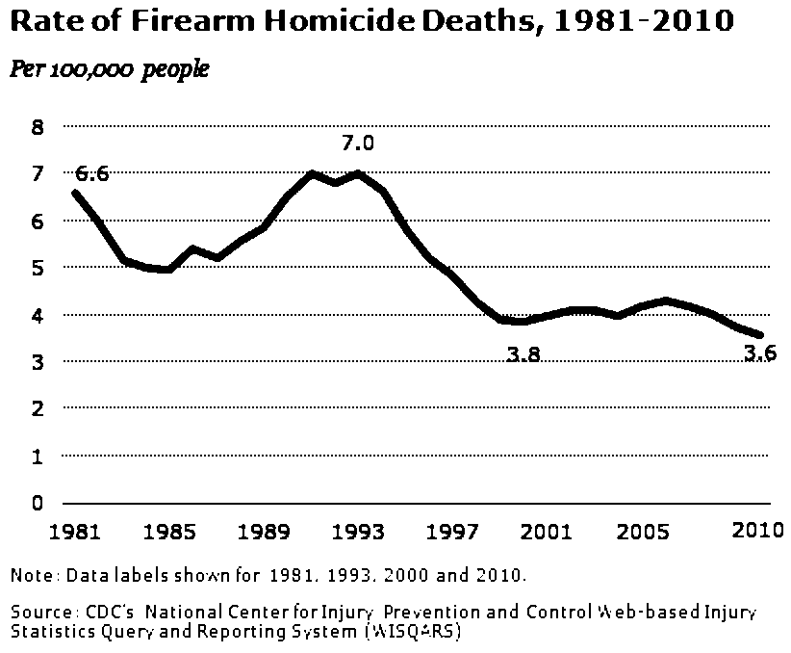
Recent History of Gun Violence in US
◀From Pew Research Center

Slide 4

Gun Violence in America
• According to the CDC in 2015, the total number of firearm deaths was 36,252
• This equals 11.3 deaths per 100,000 people
• Increased to 11.8 in 2016
• Gun violence is getting worse
• Rates of gun violence vary greatly from state to state, from 3.4 in Massachusetts to 23.3 in Alaska

Slide 5
Gun Violence in America cont.
Year | Deaths | Population | Crude Rate | Age-Adjusted Rate
2006 | 30,896 | 298,379,912 | 10.35 | 10.2212
2007 | 31,224 | 301,231,207 | 10.37 | 10.2378
2008 | 31,593 | 304,093,966 | 10.39 | 10.2317
2009 | 31,347 | 306,771,529 | 10.22 | 10.0493
2010 | 31,672 | 308,747,508 | 10.26 | 10.0708
2011 | 32,351 | 311,663,358 | 10.38 | 10.1613
2012 | 33,563 | 313,998,379 | 10.69 | 10.4472
2013 | 33,636 | 316,204,908 | 10.64 | 10.3767
2014 | 33,594 | 318,563,456 | 10.55 | 10.2637
2015 | 36,252 | 320,896,618 | 11.3 | 11.0284
2016 | 38,658 | 323,127,513 | 11.96 | 11.7263
◀From WISQUARS/CDC

Slide 6

Gun Violence in the World(OECD)
• Other countries in OECD (Organisation for Economic Co-Operation and Development) well-developed
• However, the US has the 4th highest homicide rate in OECD (34 countries)
• On average, the US has a 25.2 times higher gun homicide rate than other OECD nations (Grinshteyn, 2010)

Slide 7
How America Compares
• United States (2013), 21,175 gun suicides and 11,208 gun homicides, which is 10.64 deaths per 100,000 people
• South Korea (2013),13 gun suicides and 8 gun homicides, which is 0.04 deaths per 100,000 people
• Indicates possibility that gun laws have positive effects
South Korea outright bans civilian guns
- Most countries that do this are in Asia

Slide 8
How America Compares cont.
• The United States owns half of the civilian owned guns in the world, 6 times that of the next leading country
• The United States, as of 2013, owns 113 guns per 100 people, nearly twice that of the next leading country
• The United has twice the gun suicide rate and seven times the gun homicide rate of the next leading high income country
• The US is one of three countries with the right to bear arms in its constitution, Mexico and Guatemala are the other two

Slide 9
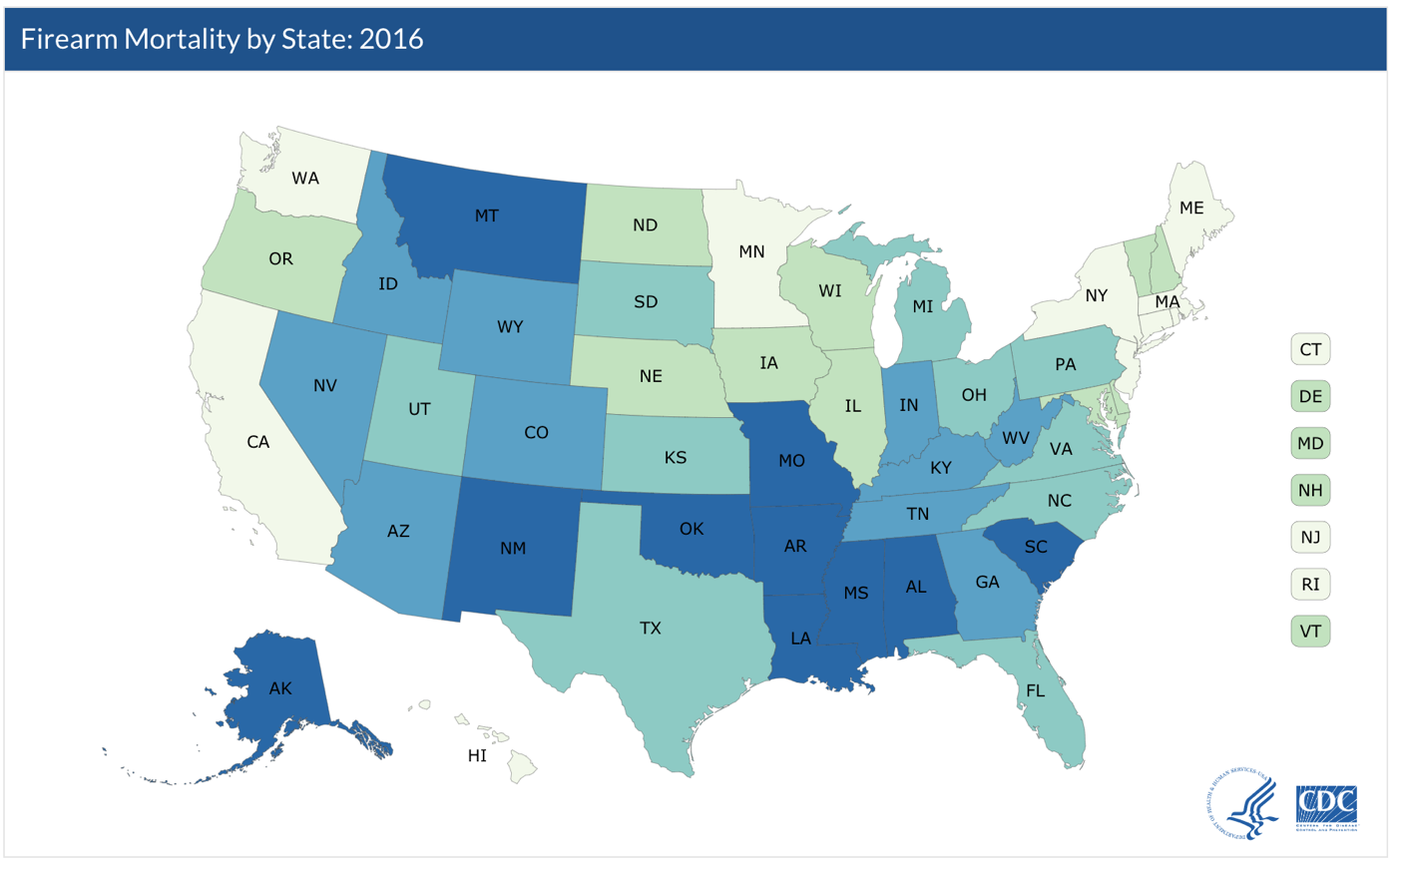
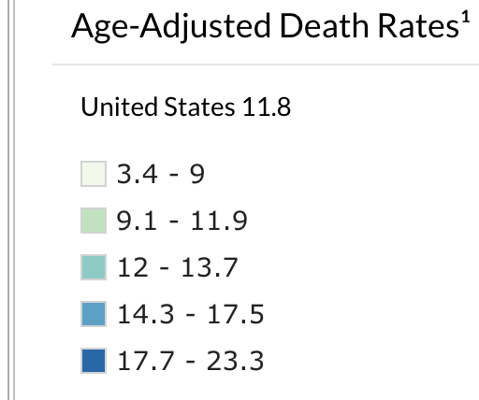
Controversy in America
◀From CDC

Slide 10
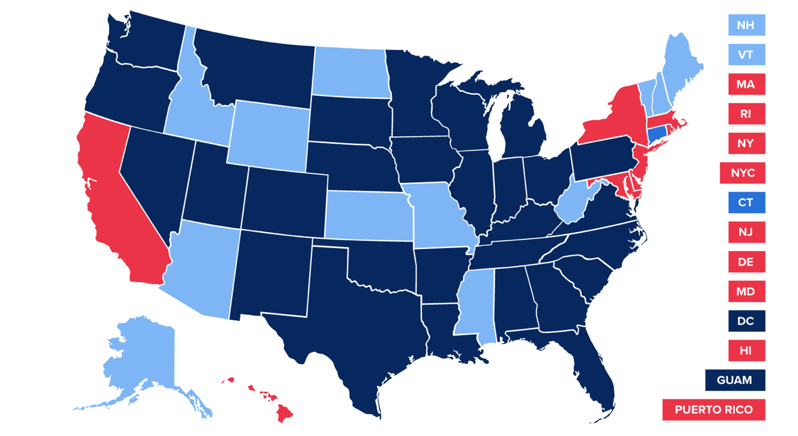
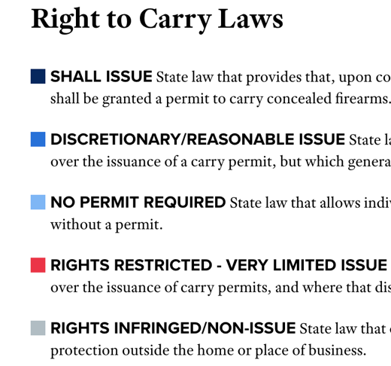
Controversy in America cont.
◀From NRA-ILA

Slide 11

Controversy in America cont.
• Gun laws vary on state and local levels
• Levels of gun violence also fluctuate by state and municipality
• Differences can be caused by many factors
Some firmly oppose firearm restriction while others agree with it
Media extensively covers mass shootings; this is bias we must avoid

Slide 12

Purpose
• We want use machine learning to determine which laws have a positive effect in reducing gun violence
• We hope for this information to have some effect on the gun violence epidemic and make some sort of difference
• Research into the causes of gun violence by the CDC was banned by congress in 1996

Slide 13

What is Machine Learning?
• Machine Learning essentially trains models through data as well as algorithms
• The main focuses of machine learning are medical (predicting seizures, analyzing cardiac arrest, etc.)
• Machine learning on social statistics, such as gun violence, is a fairly recent and innovative development

Slide 14

https://www.gunpolicy.org/firearms/region/south-korea

Slide 16

Selecting a Model
•Four major types of machine learning models: classification, regression, clustering, and dimensionality reduction
•We will use regression models because they’re meant for predicting a quantity: rates of gun violence
•Regression is great for large samples; we will start with small samples and gradually grow

Slide 17

AOS ED
• Step 1) Collect data and determine strongest laws
Collect data gun violence, control, and lawndata from 5 states and determine the strongest laws
• Step 2) Visualizing data
Create graphs and do exploratory data analysis
Look for preliminary patterns
• Step 3) Cleaning and feature editing
Modify data into easier to use format
Control for economic and age factors, such as GDP, unemployment, and median age

Slide 18

Categories of Data
•Ammunition regulation
•Assault weapons and large-capacity magazines
•Buyer regulations
•Child access prevention
•Concealed carry permitting
•Dealer regulations
•Domestic violence
•Gun trafficking
•Immunity

Slide 19
Categories of Data Cont.
•Possession regulations
•Preemption
•Prohibitions for high-risk gun possession
•Stand your ground
•Background checks

Slide 20
Stringency Algorithm
• Will not use natural language processing
• Manually check if certain phrases and/or topics are in a law
• The algorithms will be used on categories and subcategories of laws
• The algorithms will be different for each category
• Inputs will be law characteristics

Slide 21

Controls
• Poverty and socioeconomic status (Unemployment Rate)
• Race (Percentage of Blacks in Population)
• Crime rate not involving guns (Violent Crime Rate, Overall Crime Rate)
• Per-capita gun ownership (Guns Per 100 People)
• Population Density, including if the area is rural or urban
• Mental health of people involved in incidents

Slide 22
AOS ED cont.
• Step 4) Train machine learning models
Train models on law analysis
Create a function for evaluating various different regression models
Create outputs: predicted rate of gun violence
Run best model
• Step 5) Stringency algorithm
Different algorithm tailored to each category
Assigns category a numerical value that represents stringency
Retrain models on stringency scores, not law analysis

Slide 23
Big Picture: Determine Regression Model Best for Predicting Which Changes in Gun Legislation Have the Best Effect on Rates of Gun Violence
Collect Data
Format and Visualize Data
Clean data
Train models
Run best model
Stringency Algorithm
Start with 5 states, gun laws, controls and rates of firearm deaths
Split into training and test data
Inputs: law characteristics
Create graphs and plots
Retrain models on stringency scores instead of just law analysis
Different algorithm tailored to each category
Test model architectures for least error
Law analysis taken from an outside source
Identify preliminary patterns
Compare performance of models
Outputs a numerical value for category of laws

Slide 24
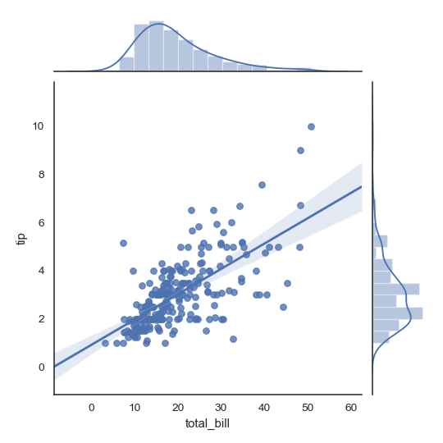
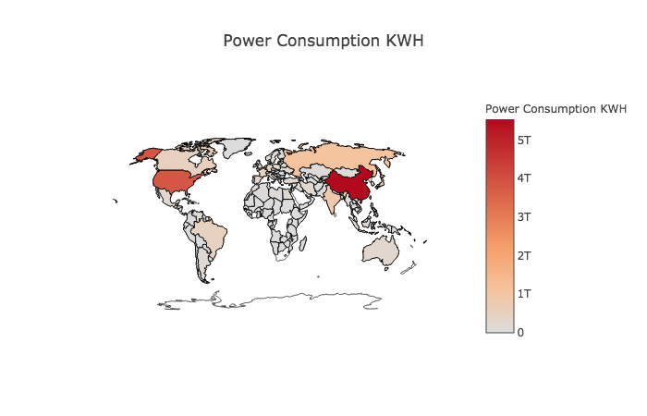

Slide 25

DSHS ED
• Same as AOS ED except for data
• Will utilize data from OECD countries over 10 non-consecutive years
• Analyzing gun laws on gun violence at international level

Slide 26

Sources
• Journals of epidemiology
• Epidemiology is the branch of medicine that deals with the incidence, distribution, and possible control of diseases and other factors relating to health
• Other medical Journals
• Public Health Journals

Slide 27
References
• Bureau of Alcohol, Tobacco, Firearms, and Explosives. (2018, April 26). National Firearms Act. Retrieved September 19, 2018, from https://www.atf.gov/rules-and-regulations/national-firearms-act
• Cohn, D., Taylor, P., Lopez, M. H., Gallagher, C. A., Parker, K., & Maass, K. T. (2013, May 07). Gun Homicide Rate Down 49% Since 1993 Peak; Public Unaware. Retrieved September 19, 2018, from http://www.pewsocialtrends.org/2013/05/07/gun-homicide-rate-down-49-since-1993-peak-public-unaware/
• Delay, B. (2017, Oct 12). A History of Violence: The U.S. Government’s Relationships With Guns And The NRA. Retrieved September 19, 2018, from https://psmag.com/news/us-government-and-the-gun-industry
• Fatal Injury Reports, National, Regional and State, 1981 – 2016. (n.d.). Retrieved September 19, 2018, from http://www.cdc.gov/injury/wisqars/fatal_injury_reports.html

Slide 28
References cont.
• Fox, K. (2018, March 09). America's gun culture vs. the world in 5 charts. Retrieved September 19, 2018, from https://www.cnn.com/2017/10/03/americas/us-gun-statistics/index.html
• Grinshteyn, E. & Hemenway, D. (2016). Violent Death Rates: The US Compared with Other High-income OECD Countries, 2010. US National Library of Medicine, 129(3), 266-73. Doi: 10.1016/j.amjmed.2015.10.025
• Gun Laws. (n.d.). Retrieved April 26, 2018, from https://www.nraila.org/gun-laws/?page=537&state=0&startDate=&endDate=&search=&contributor=0&contentBuckets=8180,8176&geo=
• Kiersz, A. & LoGiurato, B. (2015, June 18). Obama was right when he said ‘this type of mass violence does not happen in other developed countries’. Retrieved September 19, 2018, from https://www.businessinsider.com/oecd-homicide-rates-chart-2015-6

Slide 29
References cont.
• Krug, E., Powell, K., & Dahlberg, L. (1998). Firearm-related deaths in the United States and 35 other high- and upper-middle-income countries. International Journal of Epidemiology,27(2), 214-221. doi:10.1093/ije/27.2.214
• Longley, R. (2018, August 4). See a Timeline of Gun Control in the United States. Retrieved September 19, 2018, from https://www.thoughtco.com/us-gun-control-timeline-3963620
• Lopez, G. (2018, June 29). America’s unique gun violence problem, explained in 17 maps and charts. Retrieved September 19, 2018, from https://www.vox.com/policy-and-politics/2017/10/2/16399418/us-gun-violence-statistics-maps-charts
• National Center for Health Statistics. (2017, May 03). Retrieved April 26, 2018, from https://www.cdc.gov/nchs/fastats/injury.htm

Slide 30
References cont.
National Center for Health Statistics. (2018, January 10). Retrieved April 26, 2018, from https://www.cdc.gov/nchs/pressroom/sosmap/firearm_mortality/firearm.htm
OECD Watch. (n.d.). Retrieved September 19, 2018, from https://www.oecdwatch.org/oecd-guidelines/oecd
OJJDP. (n. d.). Section I: Gun Violence in the United States. Retrieved September 19, 2018, from https://www.ojjdp.gov/pubs/gun_violence/sect01.html
Zhang, S. (2018, February 15). Why Can't the U.S. Treat Gun Violence as a Public-Health Problem? Retrieved April 26, 2018, from https://www.theatlantic.com/health/archive/2018/02/gun-violence-public-health/553430/

